Slide 1
100 DAYS ACTION PLAN, 24.11.2021
Dmitry Kochin
Logistics Manager Russia

Slide 2






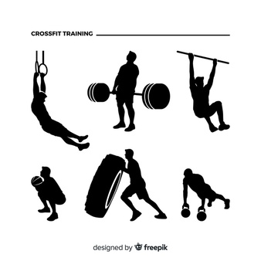

About me
Work experience:
Araymond Russia, LLC (2011-2021) (Automotive Industry)
- Supply-Chain Specialist (2011-2014)
Supply-Chain Manager (2014-2018)
Plant Manager (Operational Director)
(2018-2021)
Personal Info:
Name: Dmitry Kochin
Place of Birth: Nizhny Novgorod
Age: 33 years
Achievements:
SAP Implementation from “zero”
Production enhancements – Flow, Layout
Green Field (New Plant) launch from “zero”
Internal Customs Clearance process launch
HS codes review, saving effect 2 MRUB/Y
Launch Export flow to France, 18 MRUB/Total
Skills&Languages:
SAP (Project & Process)
Business Processes
(Mining, Mapping)
QMS
Supply-Chain Flow
Project Management
Reporting (Power BI)
Customs Clearance
ENGLISH (Advanced)
GERMAN (Starter)
Education:
Foreign Trade Manager, 2010
Translator in business
Communications, 2011
Customs Management, 2011
Supply-Chain Master (Massachusetts Institute of Technology), 2018
We should bring values, not acting as a habit…
We should Think out of the BOX…
Hobbies:
Sport (CrossFit, Sport Gymnastics)

Slide 3
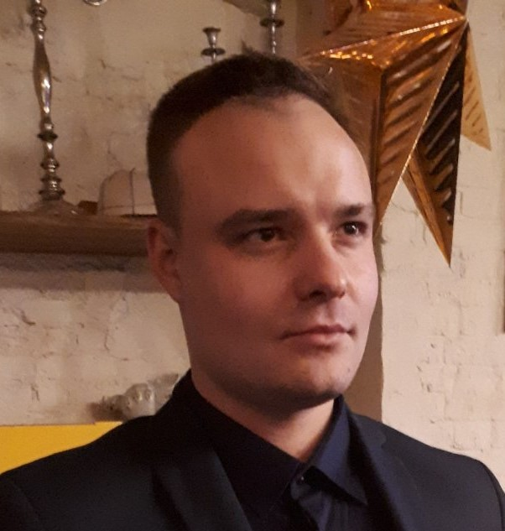
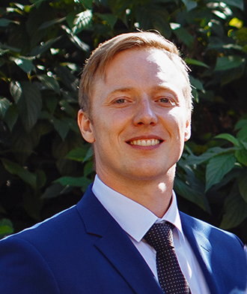


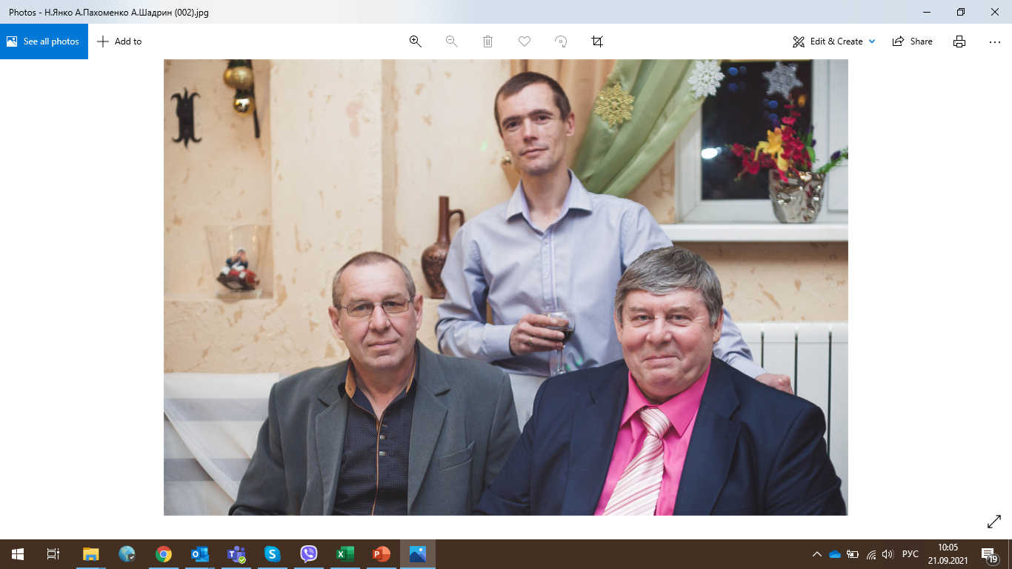
Logistics Department Structure
Role: Coordination of the Work of the Department in order to ensure uninterrupted provision of the needs of production and the End Consumer
Process Holder: Supply Chain Management
During the Absence: In Accordance with согласно DR-BODI.002R
Dmitry Kochin
Logistics Manager
Sub-Processes
1.1 Supply and Inbound Logistics
1.2 Foreign Trade Activity and Certification
1.3 Outbound Logistics
Sub-Processes Support
Roles/
Positions
Dmitry Osokin Supply Specialist
Vacant
Supply Specialist
Nikolay Sevastyanov
Supply and Foreign Trade Specialist
Svetlana Panova
Transport Specialist
Nikolay Yanko
Driver
Key Functions
Role: Uninterrupted supply of production needs from placing an Order to the Supplier to the receipt of goods and materials, packaging materials at the warehouse
Process Holder: Supply and Inbound Logistics
During the Absence: In Accordance with DR-BODI.002R
Key Functions:
1. Planning and placing orders for suppliers (goods and materials, Packaging) MRP CONTR
2. Organization of inbound transport of goods and materials from the Supplier;
3. Claim Process with Suppliers of goods and materials and Services and work on their closure;
4. Control of the correctness of execution of closing documents for supplies and transport and their transfer to the accounting department and for payment.
Role: Organization of Import-Export, Control, Certification Operations to meet the needs of production and the End User
Process Holder: Foreign Trade Activity and Certification
During the Absence: In Accordance with DR-BODI.002R
Key Functions:
1. Planning and placing orders to suppliers (Import)
2. Organization of customs procedures (Import, Export, other), Certification;
3. Control of changes in Customs Legislation;
4. Preparation and release of Customs Declaration.
5. Control of the correctness of execution of closing documents for supplies and transport and their transfer to the accounting department and for payment.
Role: Organization of outbound transport to end customers
Process Holder: Outbound Logistics
During the Absence: In Accordance with DR-BODI.002R
Key Functions:
Ordering outbound transport for timely provision of the End User
Selection of optimal transportation rates, cost control
Periodic analysis of tariff deviations
Claim Process with Service Providers
Control of tariffication, compliance with contractual conditions
Role: Support for the main processes of the Department, the Company for the organization of courier escort and delivery of employees
During the Absence: External Vendor for Taxi Services Supply

Slide 4
SWOT-Analysis Logistics Department
S (Strength)
W (Weakness)
T (Threat)
O (Opportunity)
TEAM Structure hasn’t changed
High Technological Level
Corporate culture, values, politics
High level of employee engagement, internal microclimate
High Competence level of employees and readiness to develop processes
Stable Market
Long-term age of employees in the company
Low level of process automation
Poor development of ERP capabilities SAP Systems
Complexity of processes and congestion with non-value-adding operations
Lack of clear understanding of inter-functional connections and boundaries
File and physical document flow
Outdated tariffication
Lack of structure and QMS
Implementation of Electronic Document Management
SAP Reengineering project, implementation of the WMS module
Regular review and continuous improvement of processes
Implementation of automated tools for data analysis and processing
Customs clearance as internal process
Potential to reduce operating costs
Building a QMS system
Cost control and transparent budgeting
Negative Impact of legislative factors on current processes
Increase in tariffs for international and domestic cargo transportation
The scheme of work "out of habit" hinders development and progress
Long chains of approval of changes, low speed of completion of approval procedures
Impact of the sanctions policy on the choice of a source of raw materials

Slide 5
100-days Map
Project
Internal Customs Clearance Process
QMS Build and Development
Material Master Review
Inbound and outbound Logistics Review
Belarus
Cost Saving VS External Brokerage – 600K RUB/Year
Documents standardization, Processes Description
Resource time saving for planning, Stock Value reduction
Logistics Costs Reduction
Added Value
TEAM
Timing
Q4 2021-Q1 2022
Q4 2021-Q1 2022
Q4 2021-Q1 2022
Q4 2021-Q1 2022
Details
Software License
EDS for Declarant
Electronic Declarations Connection
Training
Go-Live
Main Procedure
Flow-Map
Work Instructions
Validation & Registration
Go-Live
Review ZRAW, ZPAC Materials (MRP Parameters)
Mass Update
Check
Result Estimation
Go-Live
Inbound transport tariffs review
Online Auctions usage
Outbound Transport Strategy
Limits review

Slide 6

100-days Map. Internal Customs Clearance Process
AS-IS Process
Internal Customs Clearance Process
Shipment
Documents
Validation
Declaration
Creation
Declaration
Check &
Release
Goods Issue
& Receipt
Belarus
Cost Saving VS External Brokerage – 600K RUB/Year
GB Foods RUSSIA
Customs Brokerage
Customs Clearance Center
GB Foods RUSSIA
2020: 109 Export Declarations, 24 Import Declarations, Brokerage Costs= 1 080 000 RUB (w/o VAT)
2021: 105 Declarations, Brokerage Costs= 942434 RUB (w/o VAT)
Average Y= 1 011 218 RUB
Q4 2021-Q1 2022
TO-BE Process
Software License
EDS for Declarant
Electronic Declarations Connection
Training
Go-Live
Shipment
Documents
Validation
Declaration
Creation
Declaration
Check &
Release
Goods Issue
& Receipt
GB Foods RUSSIA
GB Foods RUSSIA
Customs Clearance Center
GB Foods RUSSIA
Investment PLan:
ALTA License: 50100 RUB/Y
Declarations: average 124 declarations/Y, 138Rub per Declaration, 17112 RUB/Y
EDS: 5000 RUB/Y
Total Investment per year: 72 212 RUB
Total Yearly Saving Potential: 1 011 218 – 72 212= 939 006 RUB/Y
Review the Customs Value Approach (Transport Cost Split): 20 Import Decl, 35-50KRUB saving, Y.Potential: 800 000 RUB/Y

Slide 7
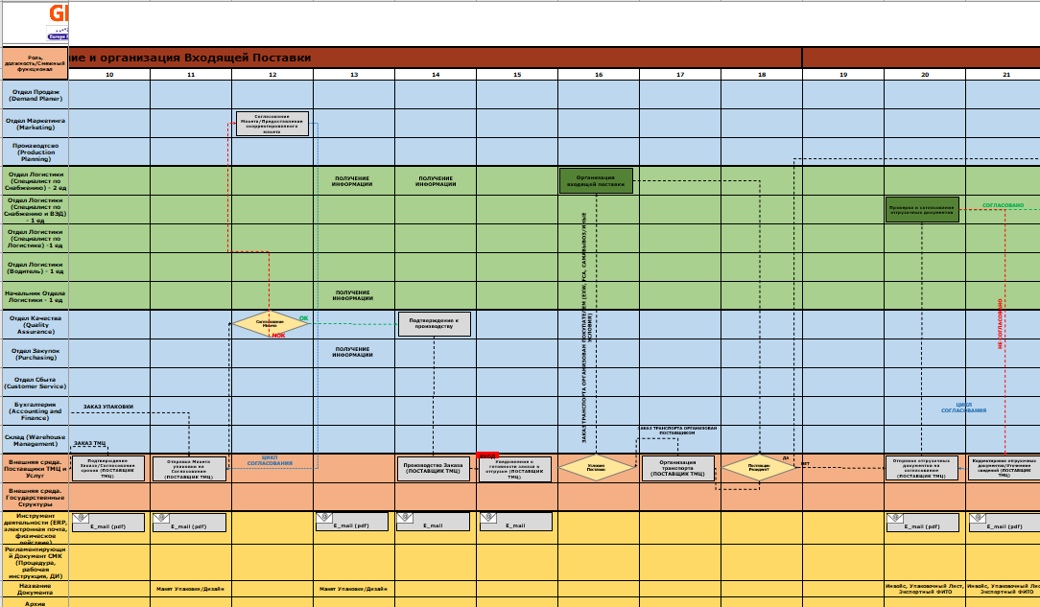


100-days Map. QMS Build and Development
QMS Build and Development
STEP 1.
FLOW-DIAGRAMM
Creation
STEP 2.
Procedure Creation
STEP 3. Forms,
Registers, Reports
creation
STEP 4. Work
Instructions creation
Documents standardization, Processes Description
Q4 2021-Q1 2022
AS-IS Sept 2021: No QMS System in Logistics Department
No process flows, Steps Descriptions, Work Instructions
TO-BE: QMS System creation in Logistics Department
Electronic Docflow Implementation (proposed 1C Docflow)
Main Procedure
Flow-Map
Work Instructions
Validation & Registration
Go-Live

Slide 8
100-days Map. Material Master Review
Material Master Review
Drivers
SCOPE
Expected Result
Resource time saving for planning, Stock Value reduction
Current MRP systems works not in a proper way
Material Master Settings to be revised (leat-time, MRP type, Lot size, Safety days)
MRP Planning is to targeted for stock optimization
Lot’s of additional excel mode, instead of SAP process
Review list of materials ZRAW, ZPAC, ZSEM, ZFIN
Adapt MRP settings
Group materials via MRP CONTR
RUN the process of local MCD
Administrate MM
Local Production Planning
Real Picture of short-term planning
Better stock situation, no overstock
Better Supply-Chain planning – frequency, transport costs
SUM result could be estimated after project done
Q4 2021-Q1 2022
Review ZRAW, ZPAC Materials (MRP Parameters)
Mass Update
Check
Result Estimation
Go-Live

Slide 9
100-days Map. Inbound and outbound Logistics Review
Inbound and outbound Logistics Review
Drivers
SCOPE
Expected Result
Logistics Costs Reduction
Last update of transport tariffs done 2017-2018
Not actual transport limits
Lack of transport strategy
No regular transport report
Potential to improve logistics schemes
Review actual tariffs
Compare the tariffs by regions, Federal Districts
Choose the best proposals for each region→ship-to
Switch cross-dock flows to pick-up from Bor
Transport strategy
Auction Transport Ordering
Cost Saving till 5% for initial run
Forwarder map for direct and cross-doc
Monthly transport reporting
Q4 2021-Q1 2022
Inbound transport tariffs review
Online Auctions usage
Outbound Transport Strategy
Limits review

Slide 10
After 100 Days
Value I could be for the company
SAP Project
Local MDC
Business Process Review
Edoc Implementation
OrgStr Review
SAP Re-engeneering Project Leading Potential
Experience from Previous Job
Administration of SAP, enhancement, automatization, Master Data Administration
Experience from Previous Job
Review internal processes, re-engineering of existing cross-functional flow, Launch of Operations Excellence board with cross tasks and projects
Experience from Previous Job
Implementation of eDoc solution, creation of workflows inside the company
Support of QMS system (1C Doc)
Experience from Previous Job
Transfer Logistics→Supply-Chain Process, Join Customer Service and Warehouse in Structure, it would be one flow Customer-to-Customer

